Slide 1

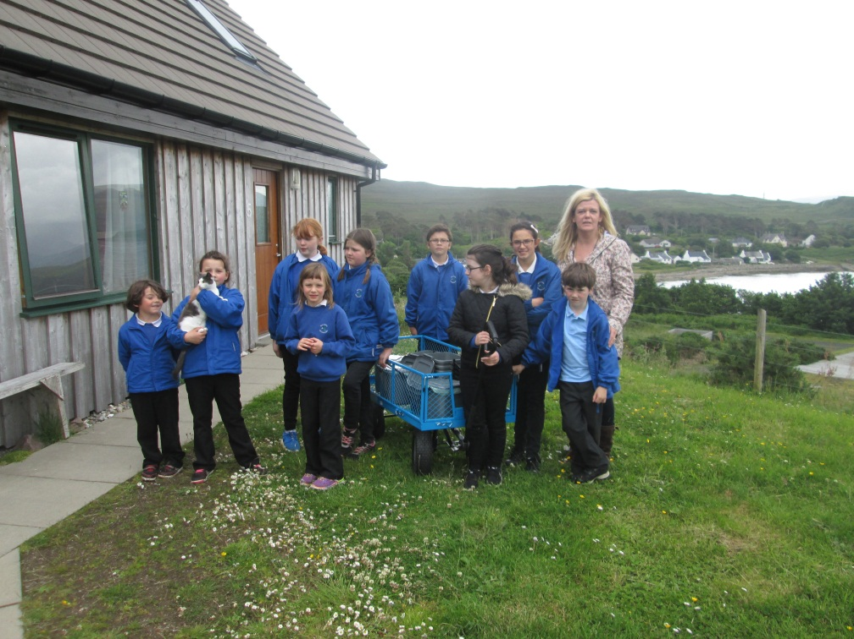

Raasay Primary
All Weather Gardening

Slide 2


Why did we decide to set up the scheme?
We live on a windy island and our polytunnel kept blowing down so we couldn’t grow food all year round.
We decided to set up a composting scheme as we were not happy about the amount of carbon dioxide which is going into our atmosphere.
We want to take responsibility for our planet by reducing our carbon footprint and share what we learn with our community.

Slide 3

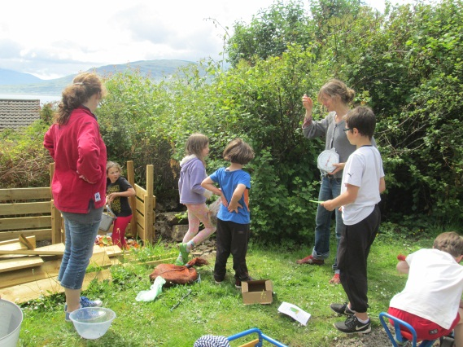
What is it all about?
We worked with the Gardening Club mums (Kate and Katherine) and applied to the Climate Challenge Fund to help us with our plans.
We have worked out that we can reduce our carbon footprint by 17.2 tonnes over 10 years with this project!

Slide 4
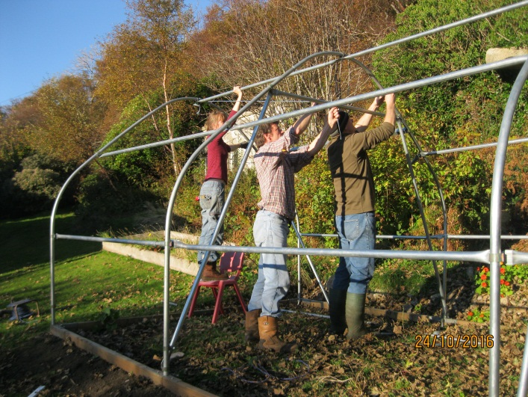

We succeeded!
The money from the CCF and the school fund meant that we could buy the materials and equipment needed to make the project happen!
Our Mums and Dads volunteered to help us order the equipment and build the poly tunnel and compost bins.

Slide 5
Headline Achievements
We have enjoyed working together to carry out this project. We have learnt some new skills: designing, planning, measuring, using a saw and drill, sowing seeds, planting on and using garden equipment.
We set up a composting scheme and saved x kg CO2e in our first year
We built a strong polytunnel that will withstand our weather and allow us to grow produce all year round.
We have formed strong links with the community in our commitment to learn about , share and take action on reducing our CO2e

Slide 6
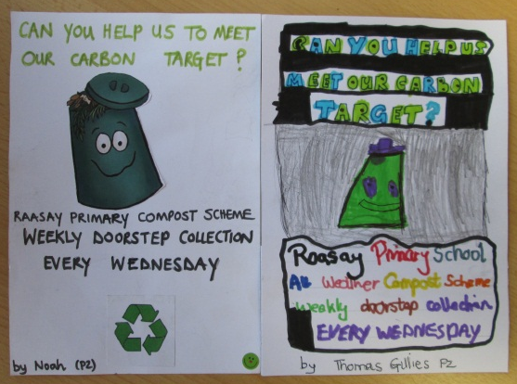
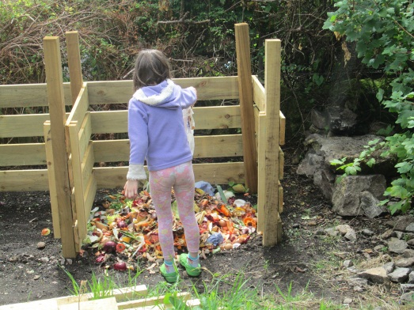
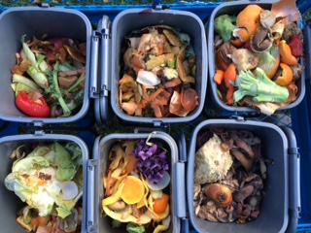
Activities: What we did
We put out regular flyers and information in the local newsletter to tell people about the project.
We gave compost caddies to the local people taking part and used our new compost trolley to collect them every week.
We recorded the weight of the waste before putting it in the compost bin.
We made 4 compost bins and we turn them when they are full to speed up the process
We went to the Community Lunch Club and did a presentation about the composting scheme. A few more people then decided to join.
At least 50 people have been involved in the project, that is 33% of our population, along with the 2 main businesses on the island.

Slide 7
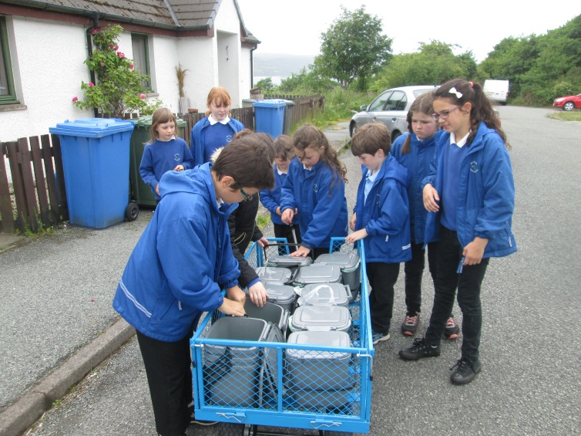
We were a bit late building the polytunnel as our parents were busy so we were not able to plant anything before February 2017.
We have now built raised beds in the polytunnel and have filled them with the first compost that we made and seaweed from the beach.
We have already planted a grape vine, herbs, broad beans and salad. And set up a corner with seats to use as an outdoor classroom.
We have ordered more seeds so we can grow our own pizza topping, and other things that we like to eat, ready for our summer fete.
We held an open day for the community to show them what we’ve achieved so far and to share what we’ve learnt.

Slide 8
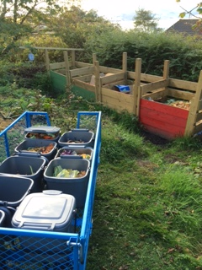
Outcomes: CO2e
How much compost?
Our compost scheme ran for x weeks and we have collected x kg
We are a bit behind our target of 2340kg per year because it took us longer than expected to build the compost bins and we also overestimated how much food waste some of the smaller households would produce
We encouraged more houses, the shop and Raasay House Hotel to join in after the scheme had started
We also put collection bins in the main village for people to drop off food waste and this worked well
We saved x kg CO2e over the project year compared to our estimated savings of
  (as per the attached spreadsheet)

Slide 9
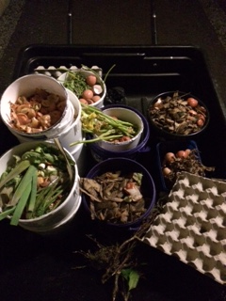
Compost Collected so far…

Slide 10
Where it all comes from…

Slide 11
Outcomes: CO2e
How much did we grow?
As we were so late getting the polytunnel built we missed the main growing season for 2016
We have now planted herbs, salads and fruit but have not yet harvested any.
We have not achieved our outcome in the project year but are on target for year 2 and we are excited about what we are growing for this year and years to come.

Slide 12
Outcomes: Community
The weekly collection has worked well and we have kept people updated with the scheme as we collect the compost caddies
Questionnaire: pupils…………………………………………
We put a questionnaire in the shop to see if there were any more people who had not yet joined our scheme. Most people had and those who didn’t were mainly composting their own waste at home
Many people who joined the scheme were not aware of what waste could be composted or why it was good to do so. The information we have given out in the newsletter, flyers and in our presentation have helped people understand why it is important.
We have had huge support and interest in the project from both local residents and businesses and we will continue to promote our scheme to the community to make it successful so we can keep making our own compost and help reduce the islands CO2e.

Slide 13
Quotes:
“ I didn’t know you could compost flowers” – Local Resident
“Thanks for showing me the photos of the process, I wondered what happened to all the food waste you were collecting” – Raasay House Chef
“It’s easy to do once you get into the routine of not putting it in the bin” – Local Resident
“The children keep reminding me what food waste I can put in the caddy” – Local Mum

Slide 14
Learning & Reflection
Our main barrier was the reliance on volunteers to do much of the initial preparation for the project. Due to other commitments we fell very behind with the construction of the polytunnel which resulted in us not being able to plant in time for the 2016 season upon which our CO2e calculations for food production were based. We have now learnt that we need to allow more time for activities undertaken by volunteers.
For the composting scheme we based our estimates on family households and did not take account of people living alone this therefore meant we had over estimated the amount of waste we would collect.
We widened the composting scheme early on to help overcome the shortfall. Raasay House Hotel joined the scheme and in peak season are creating around 10kg of non avoidable food waste every day.
We would advise other groups to not let your enthusiasm for a project over estimate what you can achieve in a short time frame.
Make your goals achievable so rather than trying to do everything at once write down ideas and incorporate them in to future plans . This will help you be more realistic whilst not curbing your enthusiasm.
It has been helpful to have regular contact with our CCF Development Officer when things haven’t gone to plan or budgets need adjusting.

Slide 15
Finance & Admin
As this was such a small project both financially (with £2437 from the CCF and £1000 from school fundraising) and practically the administration was minimal.
A local builders merchant donated some of the timber we required for the project and the cement was donated by a local resident. We then liaised with the CCF to revise our budget headings and this allowed us to:
  buy the equipment needed to put an automated watering system in the polytunnel for use during school holidays.
  purchase twice as many compost caddies as originally planned so that we could replace the full caddies with clean empty ones . This removed the need for the participants to clean them and saved the children a second journey.

Slide 16
Legacy
Due to the success of the project and the support of the community we will continue to operate the compost scheme and grow produce in our polytunnel
We have already been invited back by the Community Lunch Club and we have agreed to provide them with the fruit, vegetables and herbs for their soup and puddings
Our school events will involve our own fresh produce and will continue to inform people of the ways and benefits in reducing our CO2e
We will work closely with the Walled Garden who have just received CCF funding to get back into production and we are very excited about the opportunities this will bring for the school and the wider community.

Slide 17

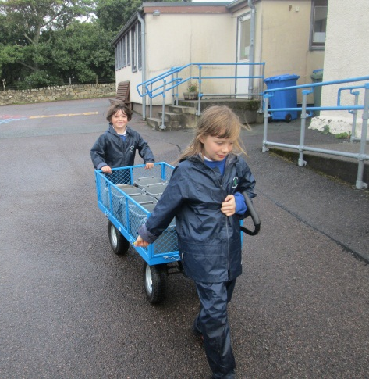
Locality is key
Compost local, grow local, eat local and make a global difference!
LITTLE CARBON FOOTPRINTS CAN TRAVEL FAR AND WIDE!

